Slide 1
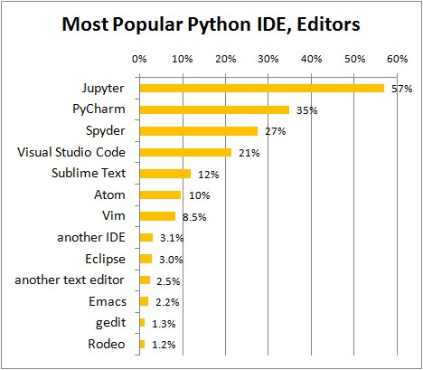
Python IDE ?
https://www.kdnuggets.com/2018/12/most-popular-python-ide-editor.html
Analysis by KDnuggets

Slide 2
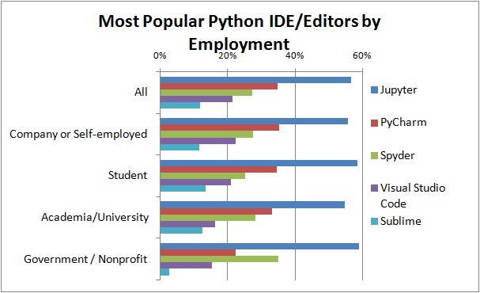
Python IDE ?
https://www.kdnuggets.com/2018/12/most-popular-python-ide-editor.html
Analysis by KDnuggets

Slide 3
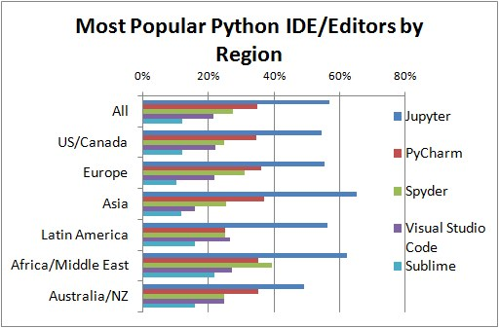
Python IDE ?
https://www.kdnuggets.com/2018/12/most-popular-python-ide-editor.html
Analysis by KDnuggets

Slide 4
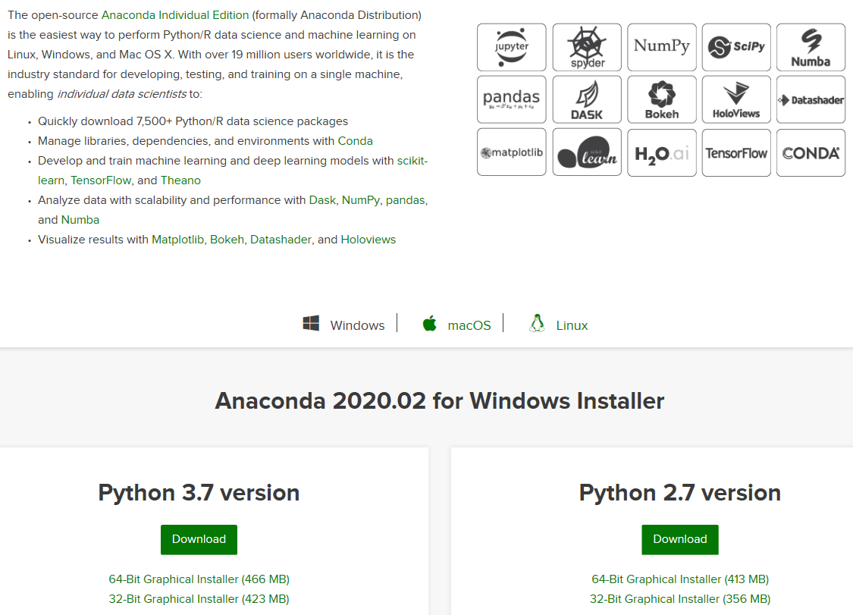
Installing Python on Window
https://www.anaconda.com/distribution/

Slide 5
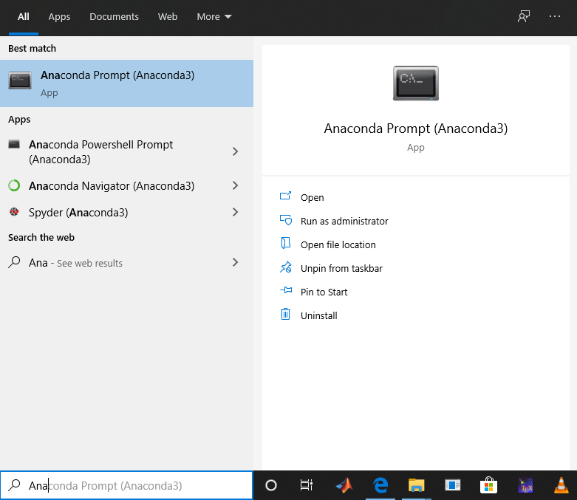
Launch Jupyter

Slide 6
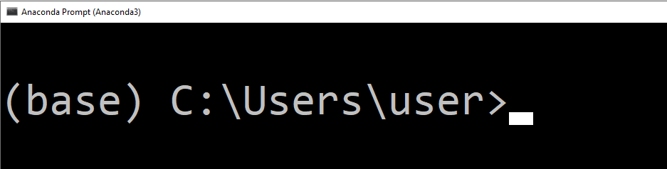
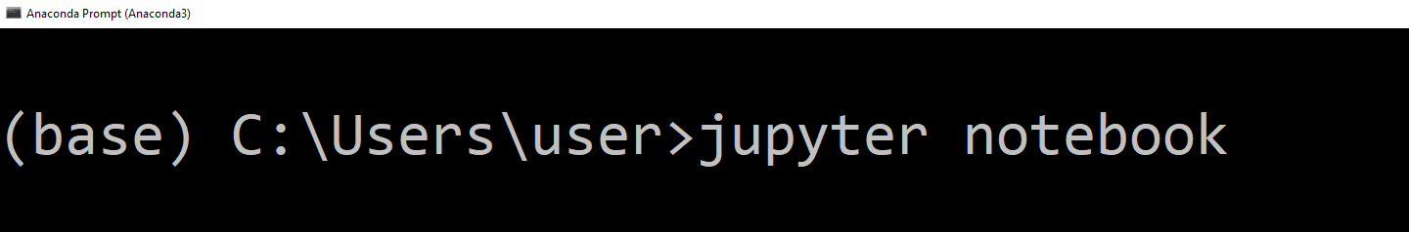
Launch Jupyter

Slide 7
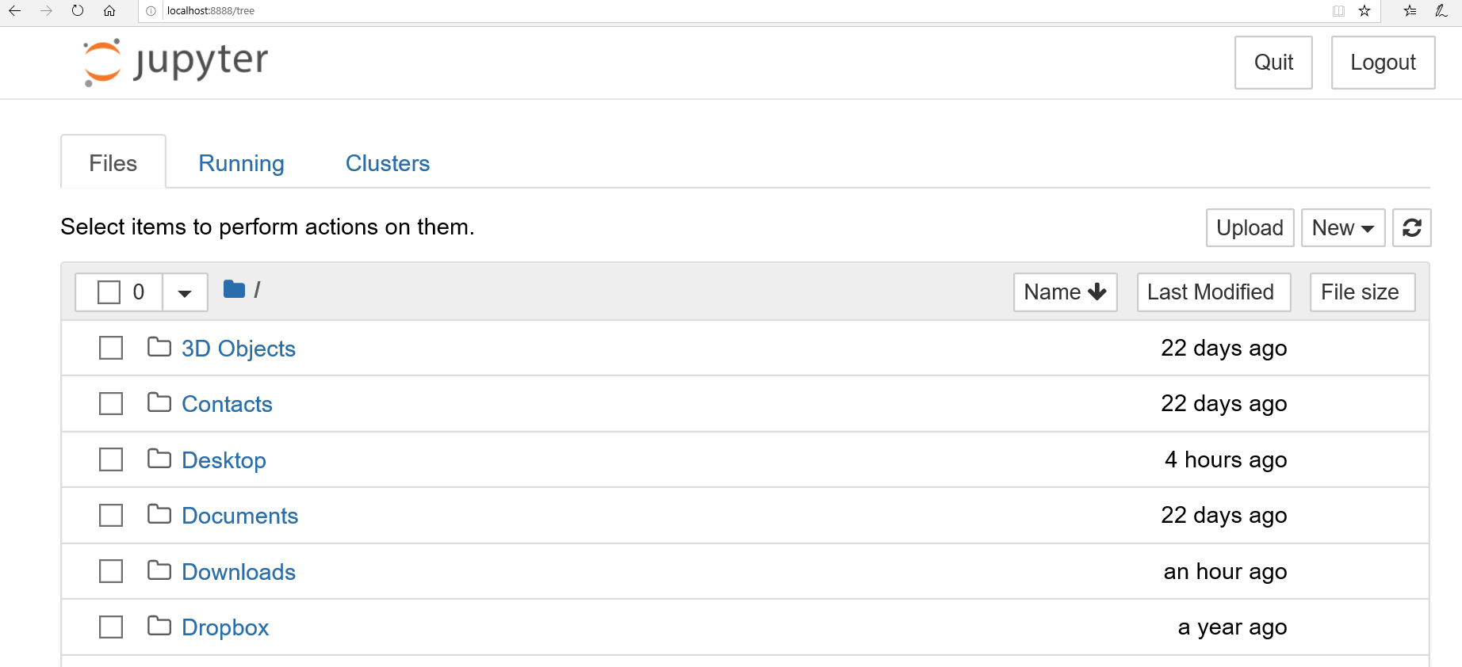
Launch Jupyter

Slide 8
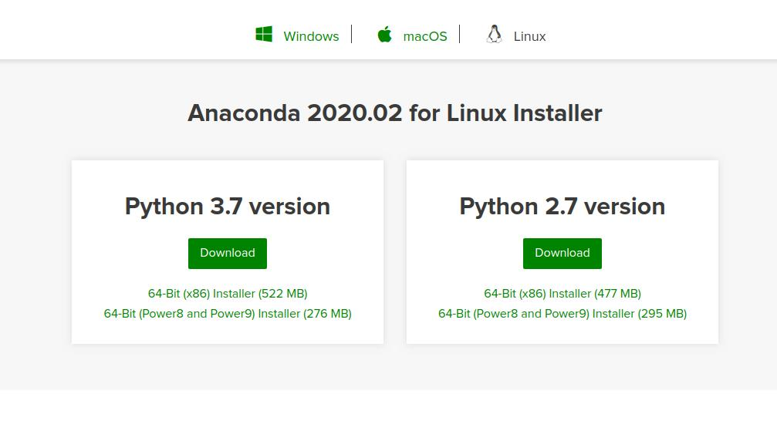
Installing Python on Ubuntu
https://www.anaconda.com/distribution/#linux

Slide 9
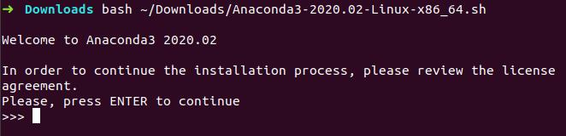
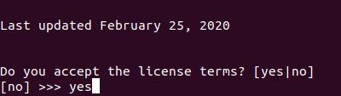
Installing Python on Ubuntu
Open a terminal and Enter the following to install Anaconda for Python 3.7:
The installer prompts “In order to continue the installation process, please review the license agreement.” Click Enter to view license terms.
Scroll to the bottom of the license terms and enter “Yes” to agree.
The installer finishes and displays “Thank you for installing Anaconda!”

Slide 10
Launch Jupyter On Ubuntu

Slide 11
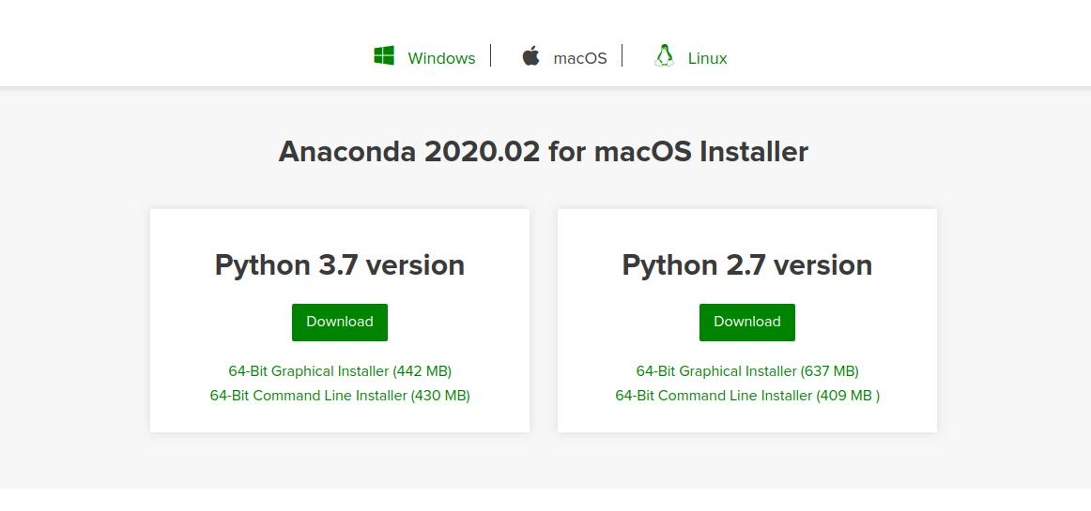
Installing Python on macOS
https://www.anaconda.com/distribution/#macos

Slide 12
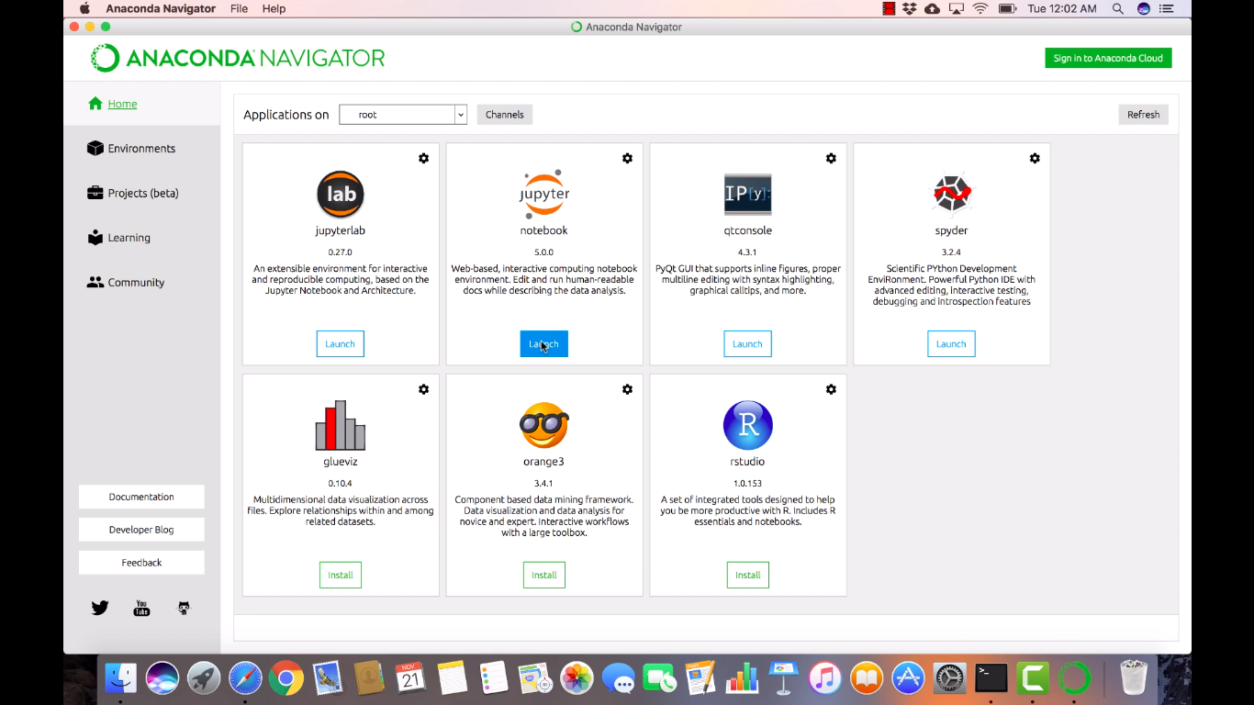
Launch Jupyter On macOS
You'll find Anaconda Navigator in Launchpad (and also in the Applications folder). Drag it to the Dock if you want to have it readily available.Then, click the Launch button below the notebook icon on the Navigator

Slide 13
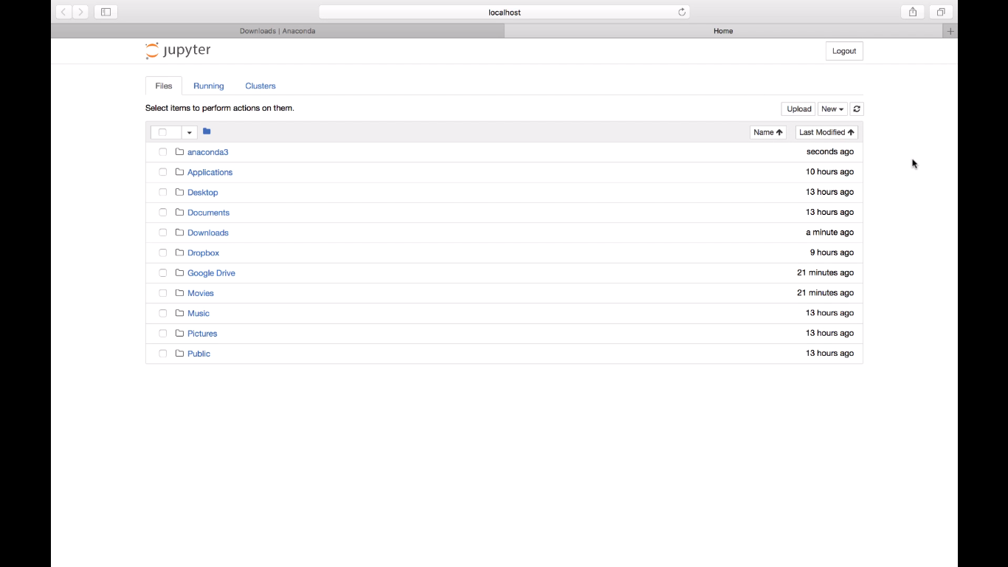
Launch Jupyter On macOS

